Slide 1

Mastering Social Connections
This presentation explores strategies from two popular books:
"How to Talk to Anyone” and "How to Become a People Magnet"

Slide 2
The Importance of Social Skills
1
Career Advancement
2
Building Friendships
Social skills are essential for career success, including networking and communication.
Strong social skills help build meaningful relationships and friendships.
3
Self-Confidence
4
Teamwork
Social skills enhance self-confidence and reduce social anxiety.
Social skills improve teamwork and collaboration in a professional setting.

Slide 3
Overview of _"How to Talk to Anyone"_
Author
Core Message
Emphasis
Leil Lowndes
Communication is key to forming strong connections.
Techniques for better conversations, making a strong first impression, and maintaining meaningful connections.

Slide 4
Key Strategies from _"How to Talk to Anyone"_
1
Smile Slowly
A slow, genuine smile makes you seem more approachable and trustworthy.
2
The Flooding Smile
Smile more often and let it radiate through your body language.
3
Using People’s Names
Remember and use people’s names to create a sense of importance.
4
Conversation Starters
Have go-to conversation starters for different settings.
5
Body Language Awareness
Non-verbal cues speak louder than words. Maintain open, inviting body language.

Slide 5
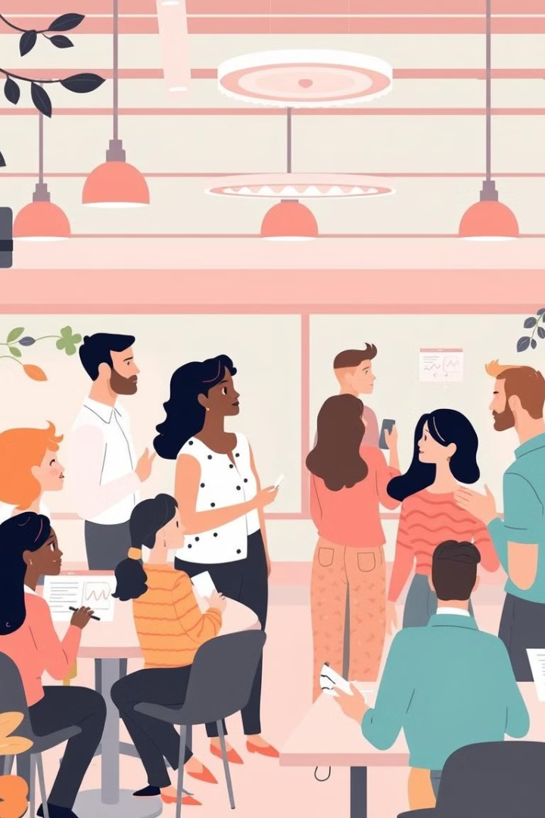
Practical Applications of _"How to Talk to Anyone"_
Workplace
Social Settings
Personal Relationships
Improves networking and communication skills.
Breaks the ice in social gatherings and parties.
Enhances communication, making it easier to connect deeply with others.
Creates lasting impressions with simple, confident gestures.
Helps to negotiate and persuade more effectively.
Builds trust and respect through verbal and non-verbal techniques.

Slide 6
Overview of _"How to Become a People Magnet"_
Author
Core Message
Emphasis
Marc Reklau
It’s possible to become more likable by making small but effective changes in behavior and mindset.
Focuses on building rapport, becoming empathetic, and genuinely interested in others.

Slide 7





Key Strategies from _"How to Become a People Magnet"_
Be Present and Mindful
Give your full attention to the person you are talking to.
Show Genuine Interest
Ask questions, and listen to understand, not just to reply.
Smile Often
A positive attitude makes you more approachable.
Positive Reinforcement
Compliment and encourage people sincerely.
Confidence in Body Language
Stand tall, maintain eye contact, and engage people with warmth.

Slide 8
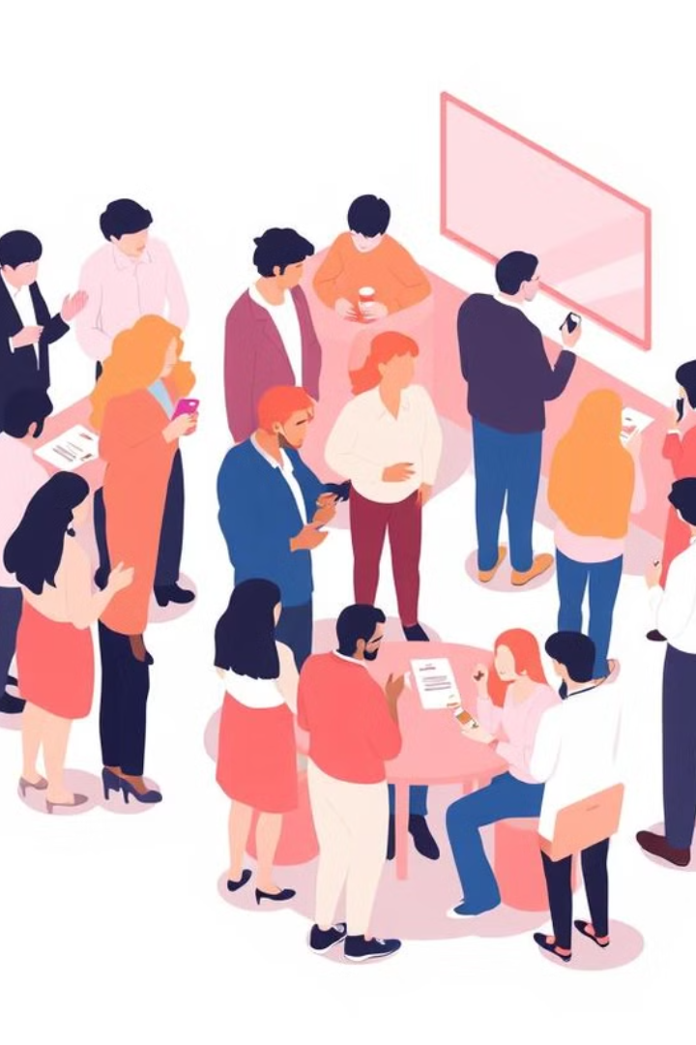
Practical Applications of _"How to Become a People Magnet"_
Networking Events
Leadership
Personal Growth
Creates an environment where people are motivated and trust their leader.
Increases your circle of influence and expands social opportunities.
Helps you stand out in a crowd by making you approachable and memorable.
Empathy and active listening can boost team morale and productivity.
Boosts self-esteem by creating more fulfilling interactions with others.
Strengthens your personal brand by leaving a lasting impression.

Slide 9
Conclusion
Mastering social skills is a valuable investment in personal and professional growth. By implementing strategies from _"How to Talk to Anyone"_ and _"How to Become a People Magnet"_, you can build stronger connections, enhance your communication skills, and become a more likable and influential individual.

